Slide 1


SMART INDIA HACKATHON 2026
Problem Statement ID – 26106
Problem Statement Title- AI-Powered Email Threat Detection, GeoLocation and Forensic Intelligence Platform
Theme- Blockchain & Cybersecurity
PS Category- Software
Team ID- RMKSIH26SW148
Team Name - RAVENFORGE

Slide 2
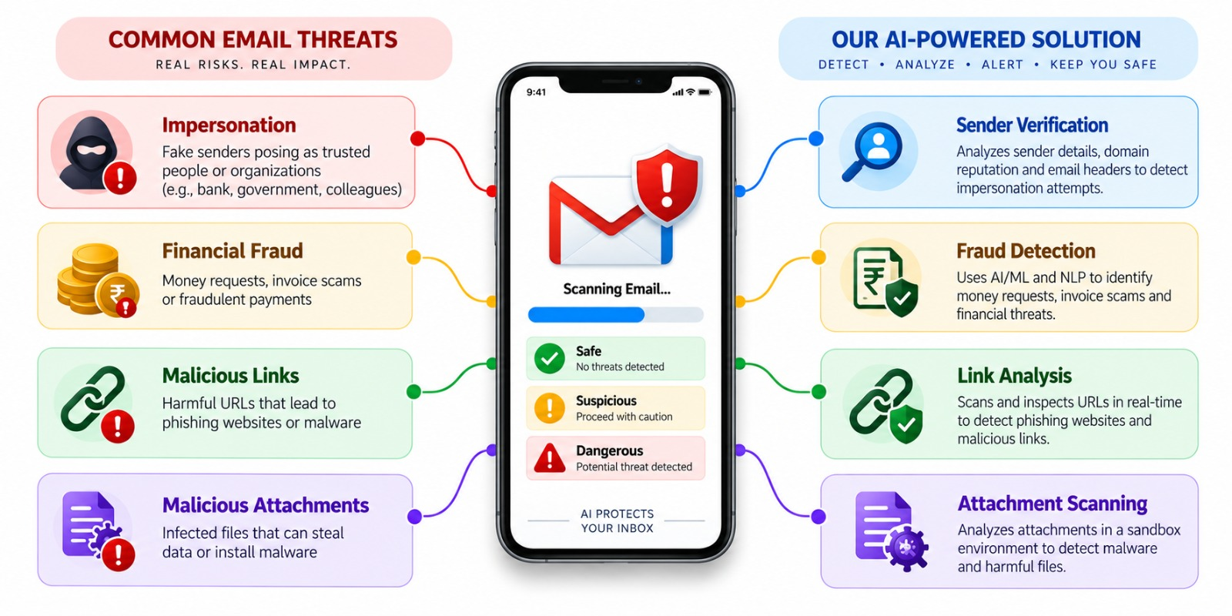
MailShield: AI-Powered Email Threat Detection, GeoLocation and Forensic Intelligence Platform
Problem:
Our idea:
Phishing, spam and AI-generated/deepfake content are increasingly difficult to distinguish from genuine communication, creating risks of fraud, identity abuse and cyberattacks.
Existing solutions often detect only individual threats and provide limited explanation, forensic evidence and privacy-preserving AI analysis.
MailShield is an AI-powered communication security platform that combines email threat detection, deepfake-audio detection and automated digital forensics in one system.
It uses ML/NLP and a privately deployed fine-tuned LLM to analyse suspicious content, explain the threat and generate actionable forensic insights without sending sensitive data to external AI services.
Proposed solution:
Innovation and Uniqueness:
Multi-layer analysis – Evaluates inbound emails through sender authentication records, textual semantics via NLP, and structural metadata—to identify sophisticated spear-phishing and spoofing attempts.
Threat classification – Each email receives an intuitive rating—Safe, Suspicious, or Dangerous—backed by clear, simple explanations so users know exactly what is wrong.
Link & attachment inspection – All embedded URLs and files are tested in an isolated sandbox and cross-checked with live threat databases before reaching the user.
Real-time alerts – Delivers proactive, in-line security banners and contextual guidance directly within the inbox, preventing user interaction with malicious payloads prior to engagement.
Unified Email + Audio Threat Detection: Detects conventional email threats alongside AI-generated/deepfake audio, rather than treating them as separate security problems.
Private Fine-Tuned AI: A LoRA fine-tuned Qwen LLM running locally through Ollama enables AI-assisted analysis while sensitive communication data can remain on the user's system.
AI-Assisted Digital Forensics: Goes beyond "spam/not spam" by combining evidence extraction, threat reasoning and automated forensic report generation.
Multi-Stage AI Security Pipeline: Combines ML → NLP → Deepfake Detection → Local LLM → Forensics, providing layered analysis instead of depending on a single model.
DEMO LINK:
CLICK HERE

Slide 3
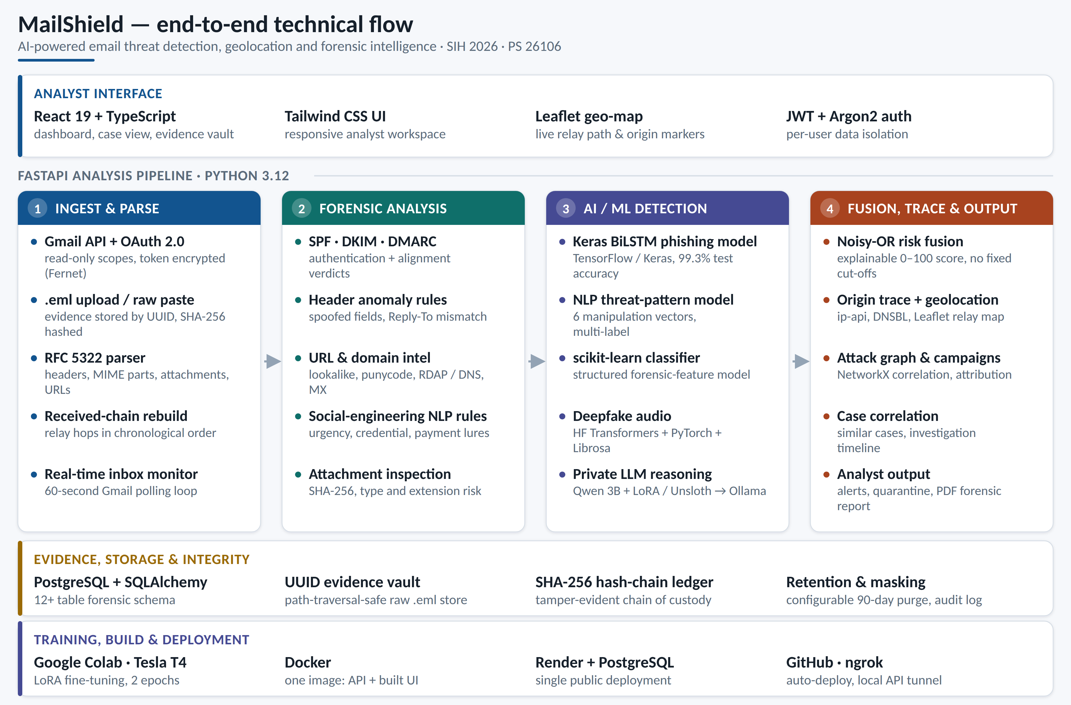
TECHNICAL APPROACH
Frontend: React-based web interface for secure login, Gmail connection, email analysis and forensic reports.
Backend: Python + FastAPI handles authentication, Gmail API communication, email processing and AI/ML inference.
Email Security: Gmail API + Google OAuth 2.0 retrieves authorized emails and processes headers, metadata, content and links for threat analysis.
ML/NLP: Machine-learning and NLP models analyse email patterns and content to identify spam, phishing and suspicious behaviour.
Deepfake Audio: Hugging Face Transformers + PyTorch + Librosa detect possible AI-generated audio using 16 kHz preprocessing and 5-second audio chunks.
Private AI: A pretrained Qwen 3B-class LLM was fine-tuned using LoRA + Unsloth on 1,800 training and 150 validation samples for AI-assisted analysis.
Model Training: Fine-tuning performed on Google Colab with NVIDIA Tesla T4, using 2 epochs.
Local Inference: Ollama runs the fine-tuned model locally, keeping sensitive analysis within the local environment rather than sending it to a cloud LLM.
Database & Deployment: PostgreSQL stores user-specific data and forensic reports; frontend/backend are deployed through Vercel + Render, with ngrok used for API tunnelling/testing.
Website link:
Website link:
DEMO LINK:

Slide 4

FEASIBILITY AND VIABILITY
FEASIBILITY
CHALLENGES
COMMERCIAL VIABILITY
STRATEGY
Existing technologies: MailShield uses proven APIs, ML/NLP frameworks and open-source AI models, making the system practical to implement.
Working prototype: Gmail integration, email analysis, forensic reporting and AI-based processing are already integrated into the prototype.
Local AI support: The fine-tuned Qwen model can run through Ollama, allowing sensitive analysis without depending entirely on cloud AI services.
Scalable architecture: FastAPI-based backend allows the email, audio and AI modules to be developed and improved independently.
Evolving threats: New phishing patterns, malicious links and AI-generated content can reduce detection accuracy over time.
Model accuracy: ML/NLP and deepfake models may produce false positives or miss previously unseen attacks.
Privacy: Emails and audio may contain sensitive personal or organizational information.
Processing time: Running multiple AI models can increase analysis time and computational requirements.
Growing need: Individuals, organizations and government departments increasingly need protection against phishing, social engineering and AI-generated threats.
Low infrastructure requirement: The platform is software-based and can be deployed on existing cloud or local infrastructure.
Multiple use cases: Can support individual users, enterprise security teams and digital-forensics investigations.
Future expansion: The platform can be extended with threat-intelligence feeds, enterprise monitoring and additional communication-threat detection.
Layered detection: Combine ML, NLP, email metadata, URL analysis and deepfake detection rather than relying on one model.
Continuous improvement: Retrain and evaluate models using new phishing, spam and synthetic-audio samples.
Privacy-first AI: Use local Ollama inference wherever sensitive information requires private processing.
Modular deployment: Keep email detection, audio detection, LLM analysis and forensics as independent modules so new models can be added without rebuilding the entire system.
DEMO LINK:

Slide 5
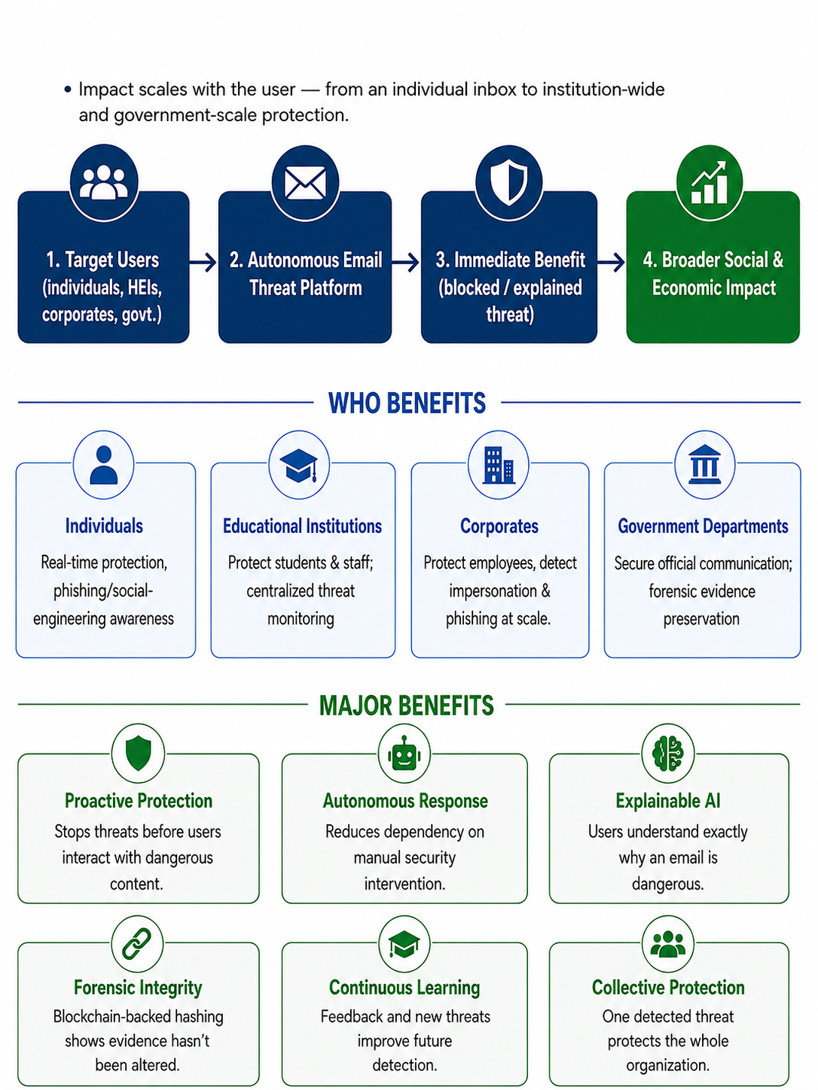
IMPACT AND BENEFITS
IMPACTS
Individuals: Alerts/quarantines harmful emails, teaches phishing awareness.
Institutions: Protects students/staff, enables admin monitoring.
Corporates: Secures employee & supplier communications, auto‑blocks phishing.
Government: Safeguards official records, supports inter‑department collaboration.
BENEFITS
Stops most threats before opening and reduces security team workload.
Explains why emails are dangerous and maintains reliable evidence records.
Learns & improves via ML and sharesprotection patterns across users.
DEMO LINK:

Slide 6
RESEARCH AND REFERENCES
REFRENCES |  | LINKS
1 | “Curated Datasets and Feature Analysis for Phishing Email Detection with Machine Learning,” IEEE, 2024. | CLICK HERE
2 | Business Email Compromise Phishing Detection Based on Machine Learning,” Electronics, vol. 12, no. 1, 2023. | CLICK HERE
3 | M. T. Banday, “Analysing E-Mail Headers for Forensic Investigation,” Journal of Digital Forensics, Security and Law. | CLICK HERE
4 | Enhanced Phishing Detection Using Multimodal Data,” Expert Systems with Applications, 2025. | CLICK HERE
5 | NIST, “Guide to Integrating Forensic Techniques into Incident Response ”,Special Publication 800-86. | CLICK HERE

Slide 7



